Slide 1



Slide 2

Inclusive education is one of the top priorities of our education system

Slide 3

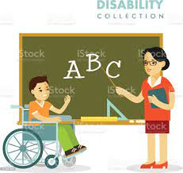
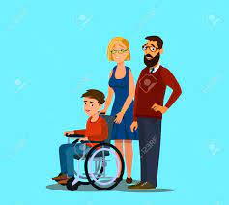
The identification of the situation of disability
- to the parents
- to the school identified by -specialist teachers, with the support of the specialized commissions CJRAE.
- classroom teachers

Slide 4
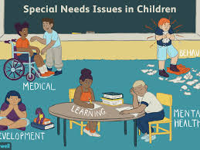
Families – ignore the problemes
ignorance
negligence
denial

Slide 5
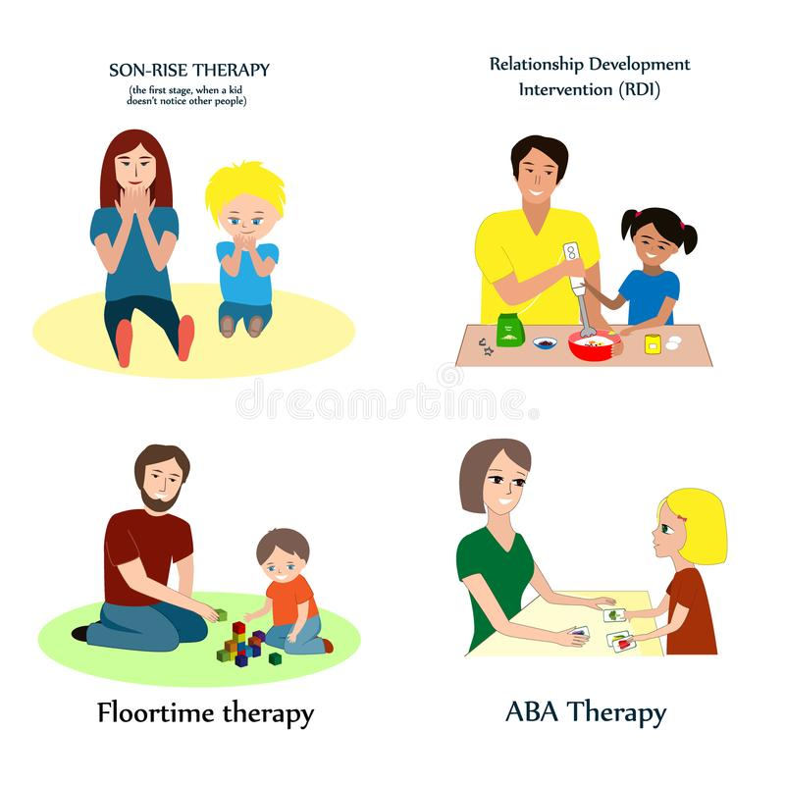

Take care of students with special needs
-teacher
- support teachers
-school counselors
-speech therapists

Slide 6

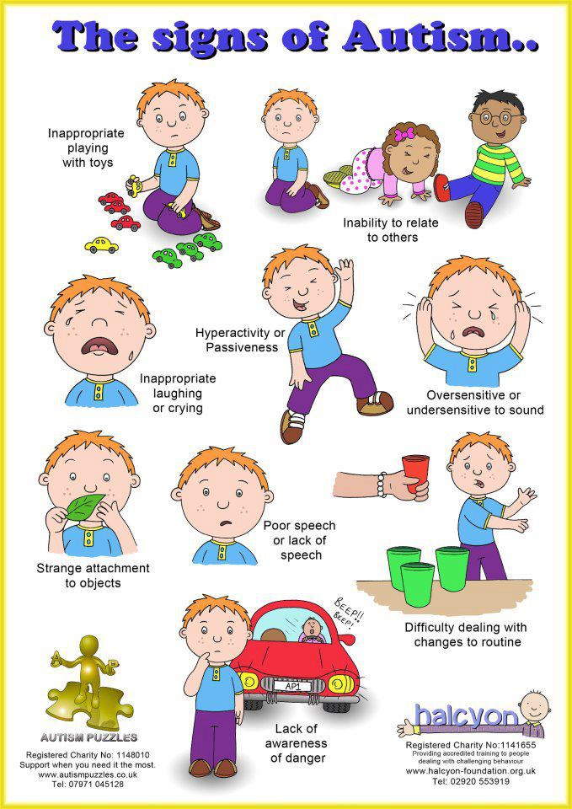

They establish the types of pedagogical intervention adapted to the individual needs of students

Slide 7

The insufficiency of the number of support teachers
The time he can allocate to students with disabilities

Slide 8

Adaptation of the national curriculum
personalizing learning objectives
personalizing learning
personalizing
assessment activities
personalizing the resources
personalizing the time needed

Slide 9


